Slide 1
Abhiejit Keshavan
About the maker
Roll no: 2021506001
Dept: Information Technology
Currently pursuing undergrad at Information Technology at Madras Institute of Technology

Slide 2
Sentiment Analysis
Using NLP toolkit and data science

Slide 3
Agenda
01
02
Problem Statement
Project Overview
03
04
End Users & Target Audience
Our solution and its ‘WOW!’
Defining our problem statement.
Knowing what’s the
essence of our project.
Defining Target audience & end users
Our unique solution to the problem

Slide 4
01
Problem Statement
Defining the problem statement of our revolutionary solution

Slide 5
Problem Statement
To analyse and understand the sentiments expressed in customer reviews of products on the Amazon using NLP techniques. The goal is to develop a sentiment analysis model capable of accurately categorizing customer sentiments as positive, negative, neutral based on the textual content of the reviews. By leveraging Machine learning algorithms and NLP tools, the project aims to provide actionable insights into customer satisfaction levels, identify areas for improvement in products of services and assist businesses in making data-driven decision to enhance overall customer experience and brand reputation.

Slide 6
02
Project Overview
Here’s all you need to know about our project

Slide 7
Primary Sentiments
Very Negative
Positive
Slightly Positive
Slightly Negative
Very Positive
Negative

Slide 8
Outcome of our model
Type of Sentiment
The sentiment of the review is analysed and found by the model
“I’ve use this product for a month and since then, it’s greattttt! Amazon delivered on time”
Customer Reviews
POSITIVE
The reviews submitted by the customers

Slide 9
Outcome of our model
Type of Sentiment
The sentiment of the review is analysed and found by the model
“I’ve use this product and this is the worst product ever! Not recommended at all”
Customer Reviews
NEGATIVE
The reviews submitted by the customers

Slide 10
This is how our classification looks
 | Review-1 | Review-2 | Review-3
POSITIVE
NEUTRAL
NEGATIVE

Slide 11
Tech stack
01
NLTK
02
ML framework
03
Pandas
04
Data Vis.
05
Numpy
06
GoogleColab
One of the natural language processing libraries.
To let machines learn over mistakes and errors
Data analysis library used for data analysis
Matplotlib and seaborn libraries are used for data visualisation.
Python library for manipulating arrays and numeral operations
Google colab platform is used to store, read and perform operations

Slide 12
03
End users &
Target Audience
Now, since our project is greatttt, everybody would need it. But we’re specific to certain audiences only.

Slide 13
End Users
Business Executives
Marketing Professionals
Require customer sentiment to make strategic decisions related to product development.
Leverage Sentiment Analysis insights to gauge customer satisfaction
Customer Experience (CX) team
Utilize sentiment analysis results to monitor customer feedback and address complaints thereby enhancing customer satisfaction

Slide 14
End Users
Data Analyst and Data Scientists
Market Researchers
Developing and implementing sentiment analysis models, conducting exploratory data analysis
To track market trends, competitor analysis, and consumer preferences.
Investors and Stakeholders
Understanding the customer sentiment to assess the company’s performance, market sentiment and potential growth opportunities.

Slide 15
04
Our Solution
This is how we solve the problem

Slide 16
Our solution
Our solution involves leveraging natural language processing (NLP) techniques to perform sentiment analysis on customer reviews obtained from the AMazon review dataset. By employing Machine learning algorithms and NLP libraries, we aim to classify customer sentiments expressed in reviews as positive, slightly positive, very positive, neutral, negative, slightly negative, or very negative, providing valuable insights into customer satisfaction levels and preferences

Slide 17

Value Proposition
Actionable Insights
Enhanced Customer Satisfaction
Competitive Advantage
Cost savings & Efficiency
Optimised Product Development
Brand Reputation Management

Slide 18
Modelling

Slide 19
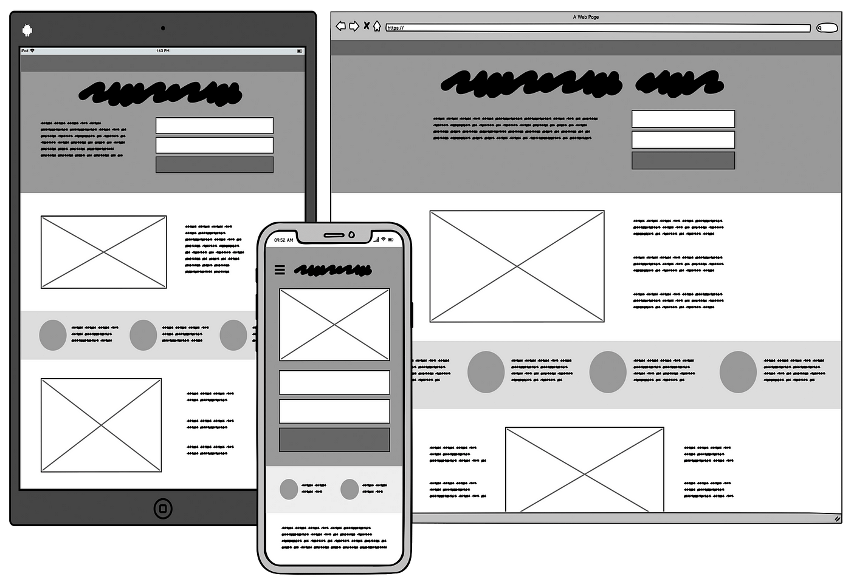
Modelling and Wireframes
Data Preprocessing
Model selection
Model training
Model Evaluation
Hyperparameter Tuning
Data analysis

Slide 20
Click below for:
Github link
Result
The sentiment analysis model effectively categorized customer sentiments into distinct categories, providing valuable insights.

